Slide 1
Wiring for Programmers and Mech

Slide 2
Basics

Slide 3
What is Grounding?

Slide 4
What is Grounding?
Grounding connects a circuit or device to the Earth's surface, providing a safe path for electrical currents to flow and preventing electrical shocks and damage.

Slide 5
Wiring Color Basics
RED- Power
BLACK- Ground
WHITE- Channel A in encoders
BLUE- Channel B in encoders
Other- Signal etc.

Slide 6
Identify these wires

Slide 7
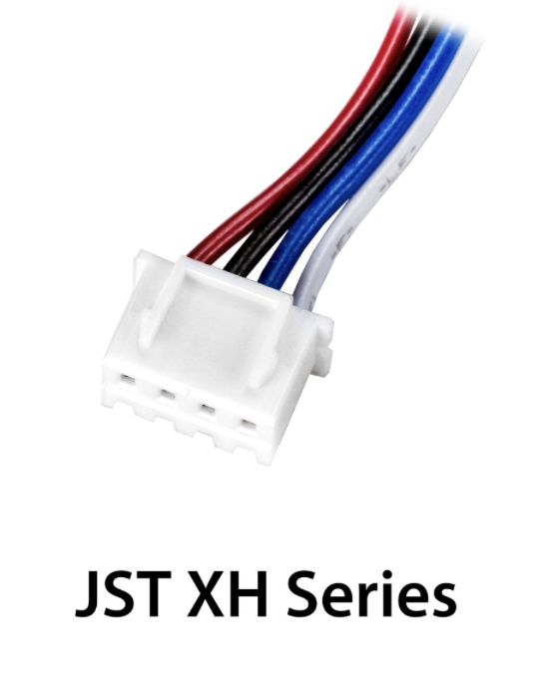
Identify these wires

Slide 8
XT-30
The XT30 connector is used in the REV ecosystem through the Expansion or Control Hub. The XT30 through the REV Slim Battery provides power to the Expansion Hub, and teams will need an XT30 cable to transfer power from the main hub to a secondary hub.

Slide 9
Anderson Power-Pole
Anderson PowerPole is a connector used by AndyMark on their NeveRest motors. PowerPole connectors are very reliable and recommended for teams. In addition, there are adapters available to other systems.

Slide 10
JST-XH
JST-XH connectors are used for the encoder connections on goBILDA (MATRIX) and Andymark NeveRest motors. Both vendors sell adapters from JST-XH to the JST-PH encoder ports on the REV Control/Expansion Hubs. These connectors are also occasionally found on some third party sensors.

Slide 11
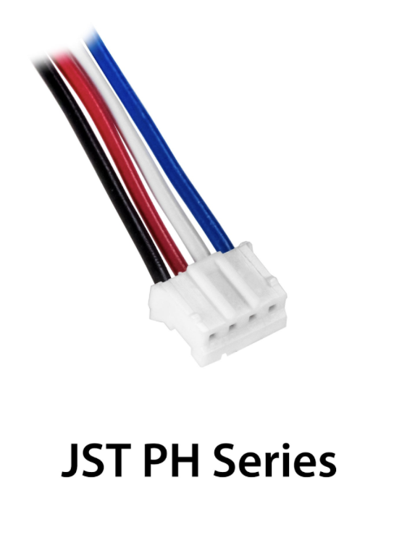
JST-PH
JST-PH is a type of connector. For FTC, the 3-pin and 4-pin options will be used most often. On the REV Control/Expansion Hubs, the 4-pin connector is used for encoder, I2C, analog, and digital connections. The 3-pin connector is used for the RS-485 connection between the Control Hub and Expansion Hub.
Notes:
These 4-pin JST-PH style connectors are used for your quadrature encoders, ALSO FOR ANALOGUE AND DIGITAL INPUTS. There are 4 of these ports on each hub and they can be used in tandem with the motor they are adjacent to. However, it is also possible to use this port to connect to a standalone incremental encoder. To connect to more than 4 encoders it is currently necessary to connect an additional hub.

Slide 12
JST-VH
JST-VH is a type of connector used by FTC motors to interface with the REV Expansion Hub. It is keyed and locks into place for improved reliability.
Notes:
These JST-VH style connectors are used to power your motors. There are 4 of these ports per hub and they are numbered from 0-3. As you are able to use 8 motors per robot you may want to control more than these hubs allow. In that case it is possible for you to use an additional hub

Slide 14
USB-C
A Control Hub has a USB-C port. This is primarily used for connecting to a laptop for uploading the SDK.

Slide 15
USB-A
A Control Hub has both a USB 2.0 and 3.0 Type-A female port. This is primarily used for connecting UVC Cameras

Slide 16
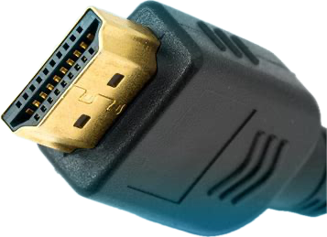
HDMI
The Control Hub lacks a display of its own even though it is a fully-fledged Android device. The Control Hub has an HDMI port that provides video output for the device; this HDMI port can be used to connect to an external display.

Slide 17
Notes:
JST-VH: Powering motors
JST-XH: For AndyMark NeveRest motors
JST-PH: Servos, analogue and digital inputs, Encoders
XT-30: Power

